Slide 1

BIO727P
Bioinformatics Software
Development Group Project
Team Liam
Vi Bui, Uppy Gill, Liam Johnson, Neha Khairnar
Tutorial – 17th February 2022

Slide 2
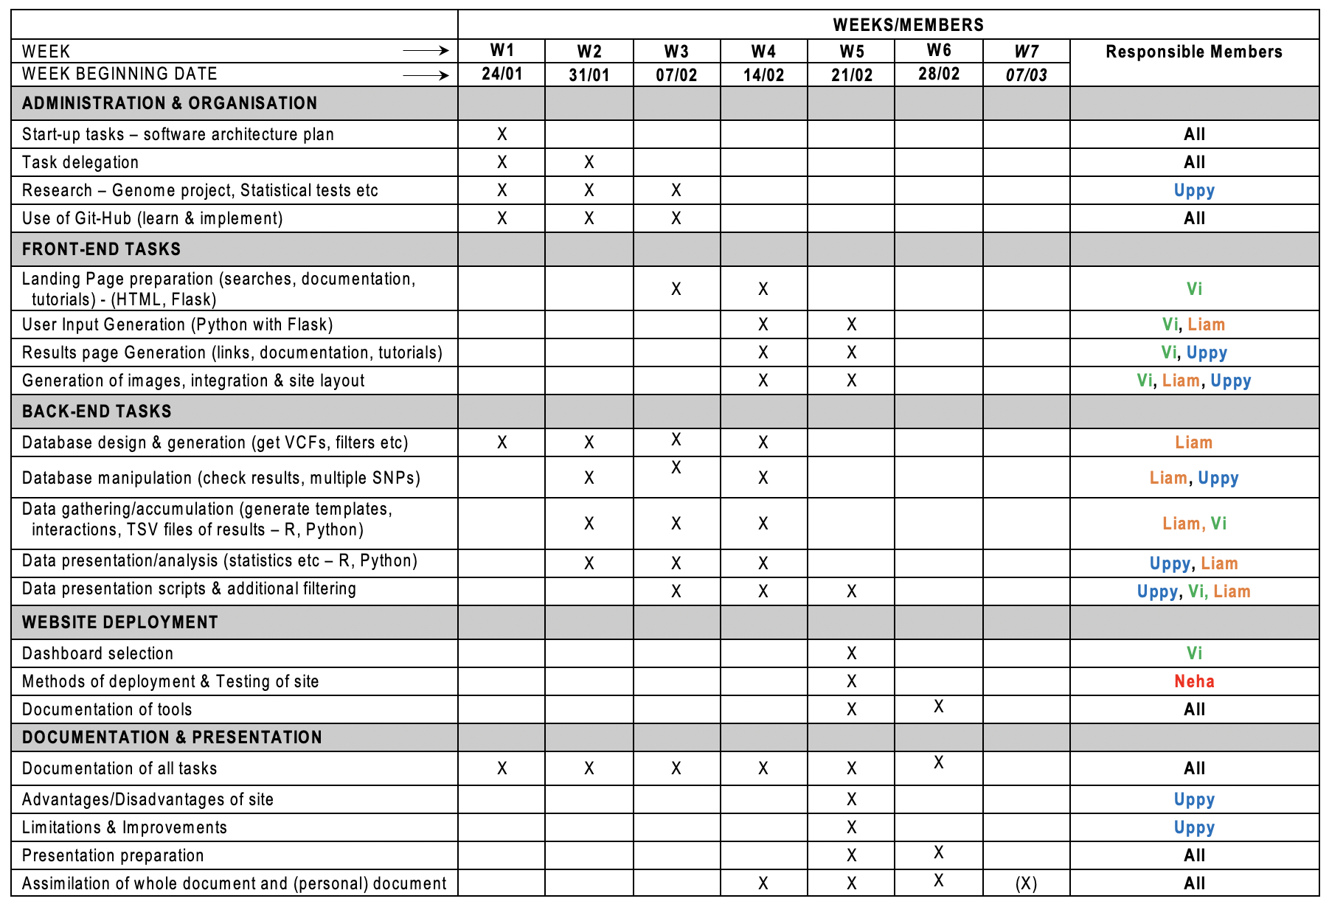
Project Plans
SNPEuro Portal

Slide 3
Progress Demonstration
Front-End (Flask)
SNPEuro Portal

Slide 4
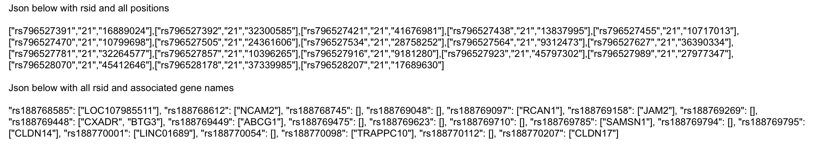
Downloaded all data from NCBI ?required
Database Preparation
SNPEuro Portal

Slide 5
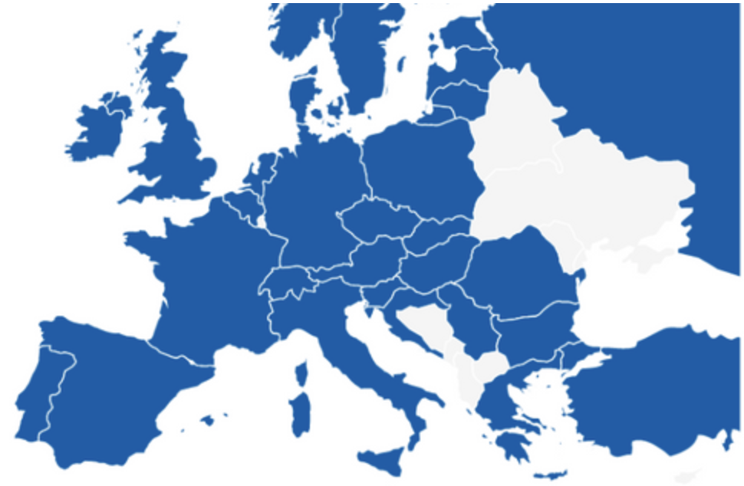
Database Preparation
Chosen populations for SNPEuro Portal:
- British
- CEPH
- Finnish
- Iberian
- Toscani
SNPEuro Portal

Slide 6
Statistical Tests
Diversity Statistics
diversity.stats.between-methods
Function to calculate nucleotide & haplotype diversities between populations
F_ST.stats-methods
Fixation index
Calculates nuc diversity within nucleotide & hap diversity within haplotype
Nucleotide diversities divided by size of region – diversities per site
Neutrality Statistics
Neutrality.stats-methods
Function to calculate neutrality statistics
Tajima’s D
SNPEuro Portal

Slide 7
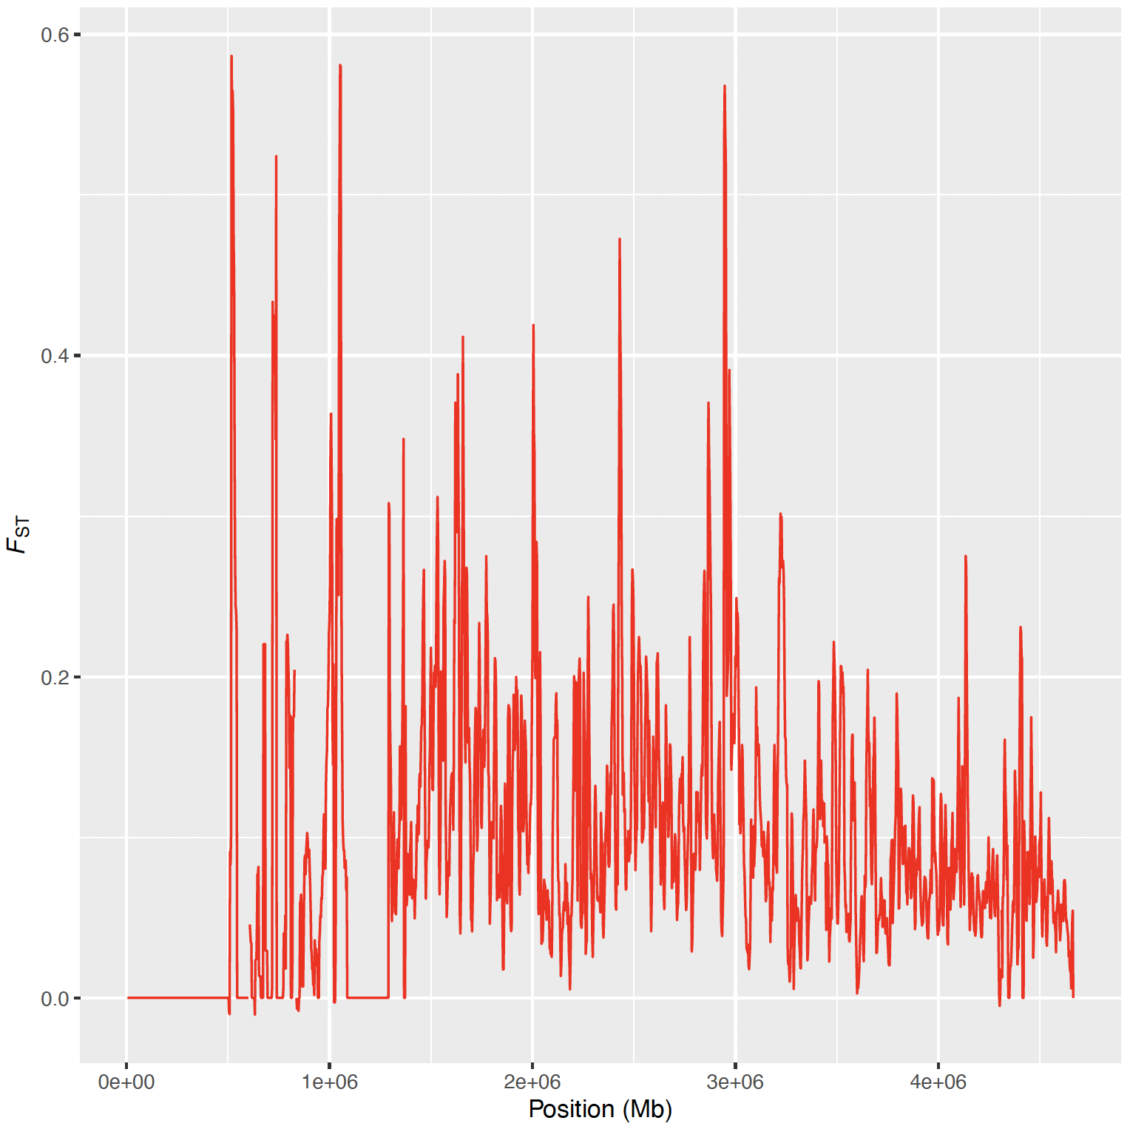
Statistical Tests – Genetic differentiation
SNPEuro Portal

Slide 8
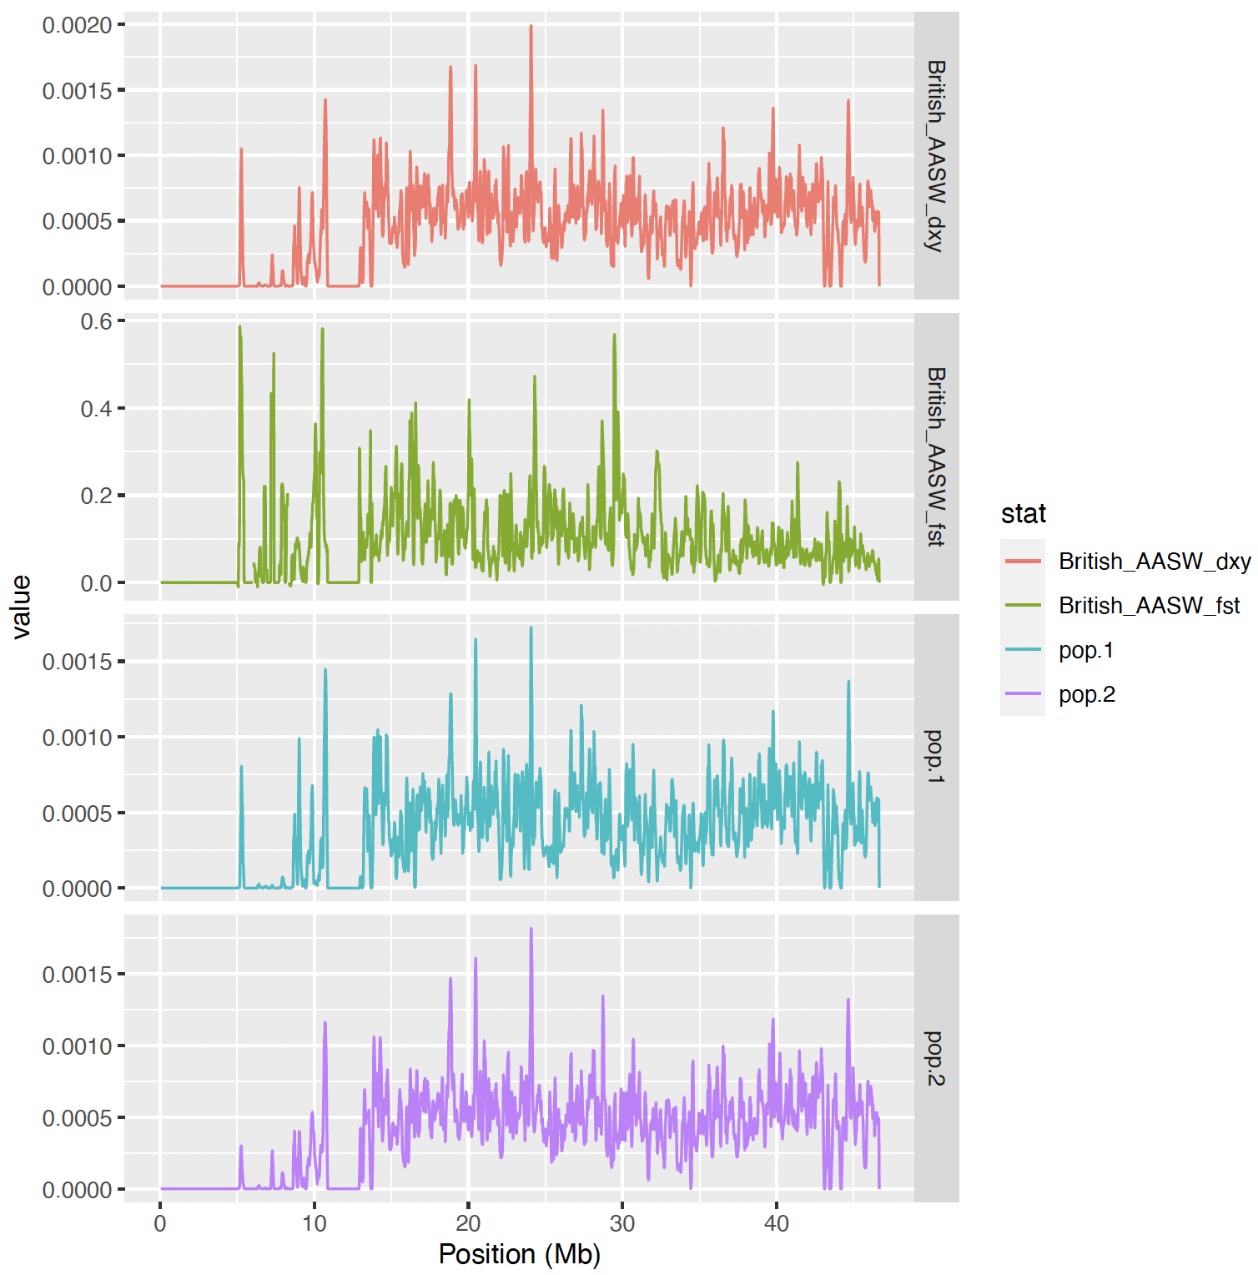
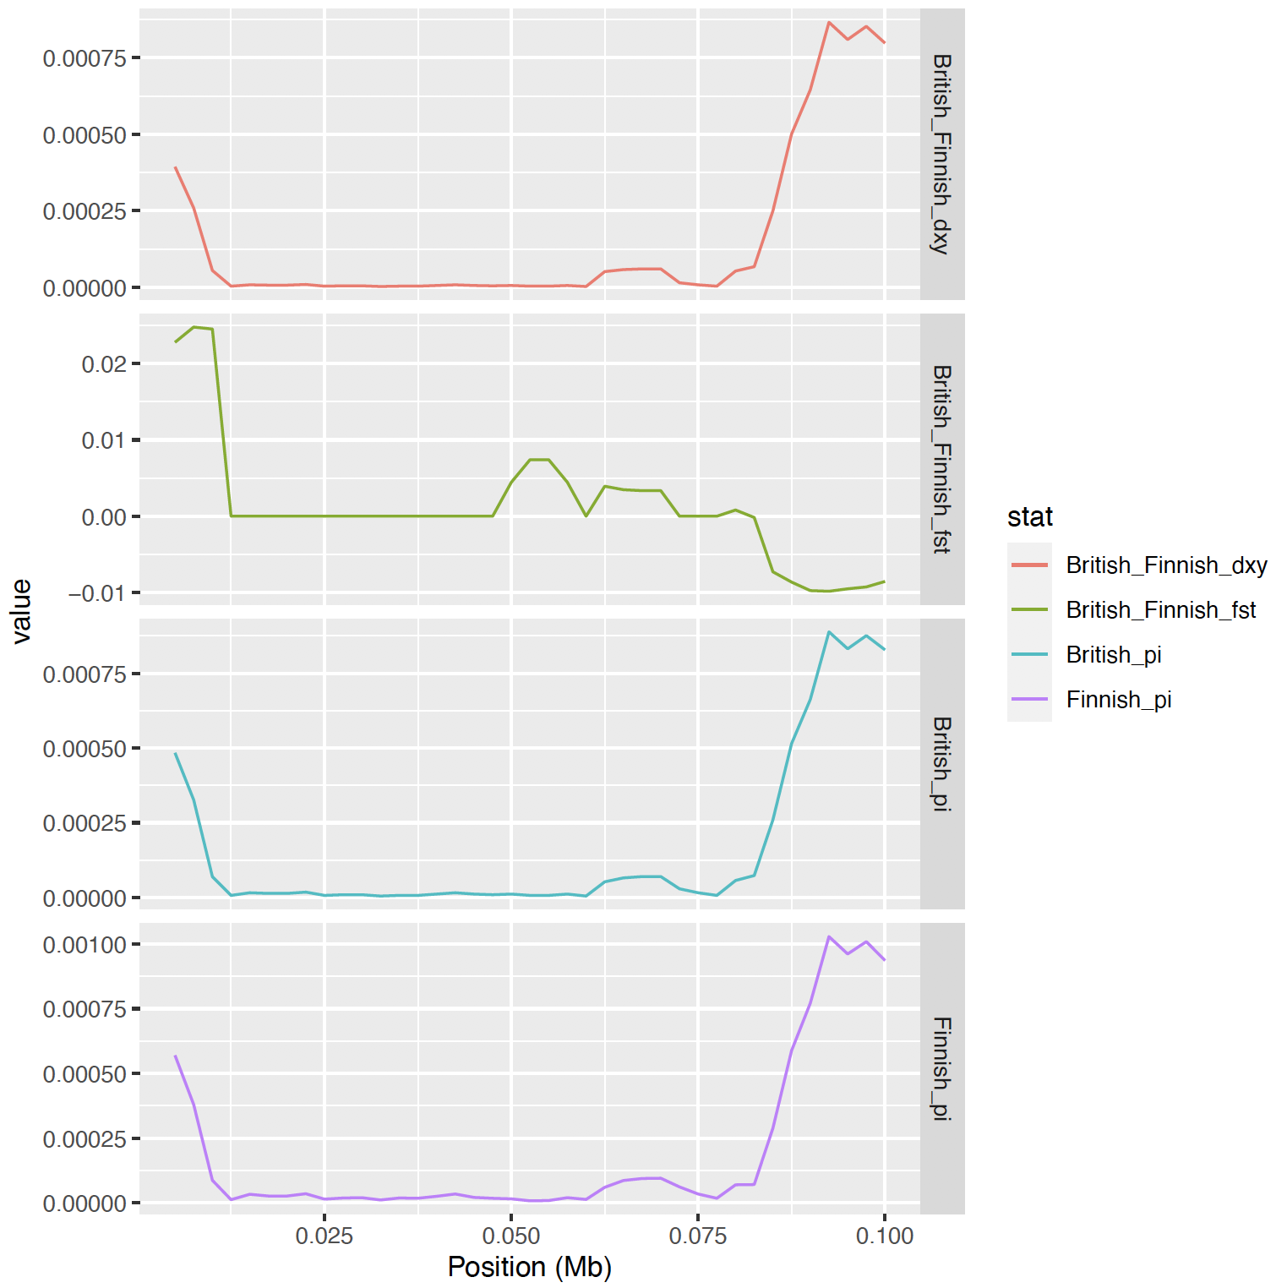
Statistical Tests – sliding windows
Absolute nucleotide divergence
Genetic differentiation
Draft attempt of British vs. African population
European populations
Nucleotide diversity
https://github.com/MSc-Bioinformatics-Group-Project/SNPEuro
SNPEuro Portal

Slide 9
Plans for remainder & next week
Database details TSV file
Use rpy2 for linking statistical code from R Flask
Results page with summary statistical tests (& images)
Modifications of website for functionality
Documentation – ongoing
Deployment
Draft presentation
SNPEuro Portal

Slide 10


